Slide 1
HTML
Lab 13: HTML

Slide 2


Welcome to HTML Class

Slide 3


What is HTML?
HTML stands for ‘Hyper text markup language’. Hypertext Markup Language is the standard markup language for creating web pages and web applications.

Slide 4
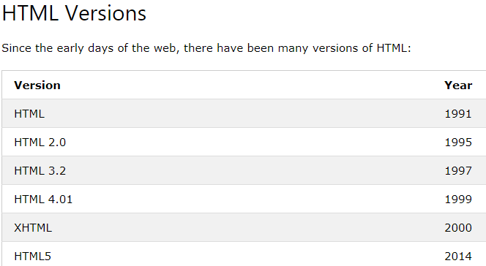
HTML Version

Slide 5
HTML Benefits
Simple to use and understand.
All browsers support HTML.
HTML and XML similar.
High speed loading time.

Slide 6

Ex1: Sample web page using HTML

Slide 7
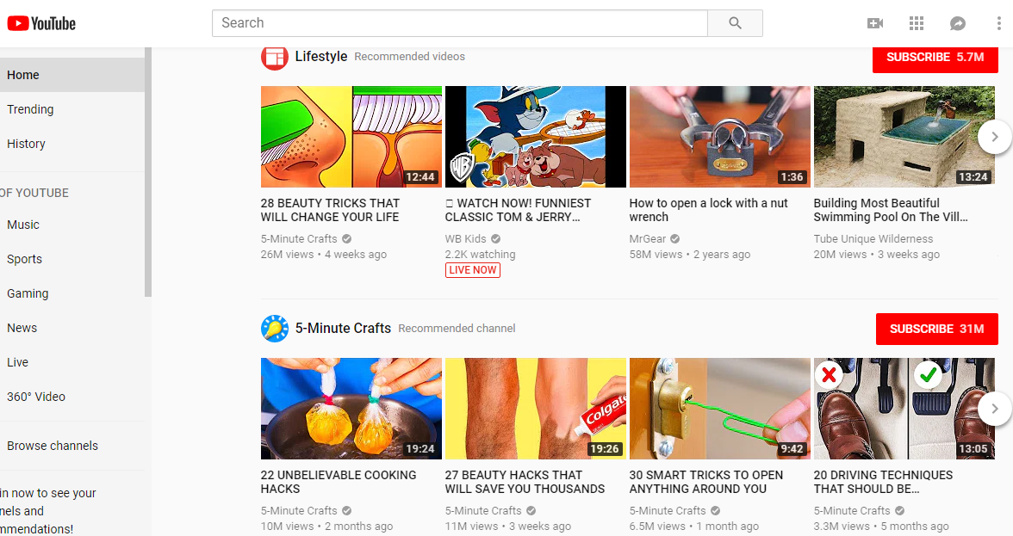
Ex2: Sample web page using HTML

Slide 8
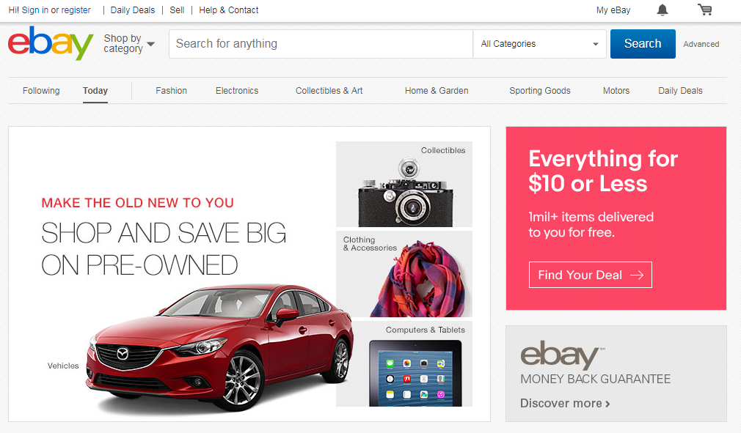
Ex3: Sample web page using HTML

Slide 9

Today’s learning:
HTML
HTML Version
Usefulness
Thank You!

